Slide 1
Predicting Ideal Haidilao Franchise Location in Singapore

Slide 2
Background
The brand Haidilao was founded in 1994. After over 20 years of development, Haidilao International Holding Ltd. has become a world-renowned catering enterprise.
Haidilao faces close competition from the Paradise Group, with its franchise Beauty in the Pot.
An investor is looking to open a Haidilao franchise in Singapore and requests that I recommend a location for them to open in.
Prospective investors for other franchises have interest as well.

Slide 3
Data Acquisition
The data of Haidilao franchises was scraped using Foursquare.
The data about the districts in Singapore can be found from Resident Population by Planning Area/Subzone and Type of Dwelling, 2015. The districts information will be used to find population clusters in order to determine customer flow rates.
The data of competitor franchises was scraped using Foursquare.
The data of mall locations available for rent was scraped using Foursquare.
Cleaned data to obtain 5 notable features.

Slide 4
Clustering
DBSCAN was used to determine population clusters
the data points are relatively close to each other, may overlap
Identified outliers where setting up franchise would not benefit.
Cluster Label | Colour | Population size (avg) | Latitude (Centroid) | Longitude (Centroid)
0 | Green | 227588 | 1.364981 | 103.743794
1 | Yellow | 160964 | 1.312217 | 103.854052
2 | Purple | 383552 | 1.337624 | 103.942858
3 | Orange | 271286 | 1.432985 | 103.832206
4 | Blue | 310810 | 1.396437 | 103.886605
-1 | Black | 235811 | 1.376222 | 103.785225

Slide 5
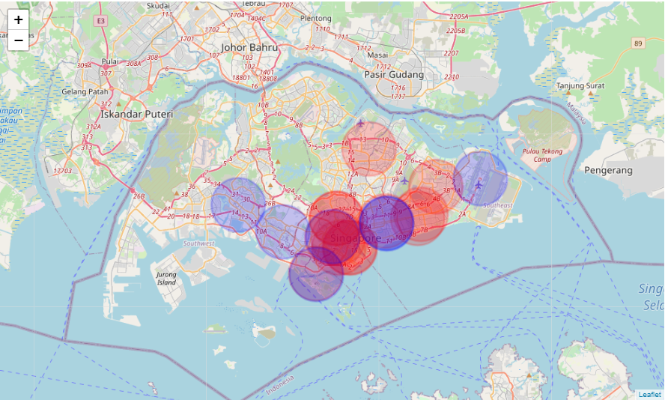
Area of Service
The approximate area where locals or nearby residents would visit that franchise if given an opportunity.
Noted that the west region and northern regions of Singapore are not covered by these franchises.

Slide 6
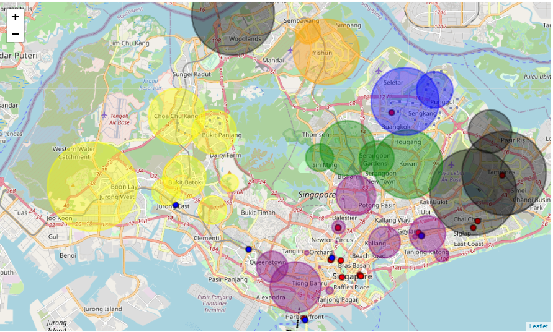
Proximity to Population Clusters
Visualise current data
Colour coded clusters
Markers sized according to population size of area
Blue markers for Beauty in the Pot and red markers for Haidilao franchise locations
Determined a relationship between cluster population size and hotpot franchise location

Slide 7
Predictive Modelling
Criteria Testing
The first criteria was determined from the formatted address. It was noticed that all franchise locations were in malls.
The second criteria ensures that the franchise is near a broad customer base.
The last criteria ensures that competition between similar franchises or outlets is minimised.
Classification Modelling
Decision Tree Classifier as relevant information was obtained, allowing for supervised learning. Output data was able to be fit into a classification Tree
Accuracy Scoring
High Accuracy

Slide 8
Future Directions
Data size is small
Add in more indicators and locations to test and train against.
Additional Testing for similarity of wide range of hotpot businesses
Determines an accurate group of competitors
Predict a range of ideal locations
Test the various districts and clusters
Search for malls with available rental spaces
Numerical scoring chart to determine the best location

Slide 9
Conclusion
Should open his franchise at Northpoint Shopping Mall, Yishun
Due to the proximity to a large population
Not served by franchises from Haidilao and its competitor

